Slide 1

Food Delivery ETA Optimization & SLA Analysis
End-to-End Analytics Project
Tools: Python | SQL Server | Power BI
Objective: Improve delivery reliability by analyzing ETA predictions, SLA breaches, and operational inefficiencies.

Slide 2
Business Problem
Problem Statement
Food delivery platforms face frequent late deliveries despite ETA predictions.
Average metrics hide high-impact delays that affect customer satisfaction.
Operations teams need visibility into why SLAs fail, not just what failed.
Goal
Predict delivery time
Identify risk and SLA breach patterns
Convert analytics into actionable business insights

Slide 3




End-to-End Workflow
Project Architecture
Raw delivery data
Python: ETA prediction & risk generation
SQL: Business views & SLA analysis
Power BI: Operational dashboards & monitoring
Design Principle
Python predicts → SQL explains → Power BI communicates

Slide 4
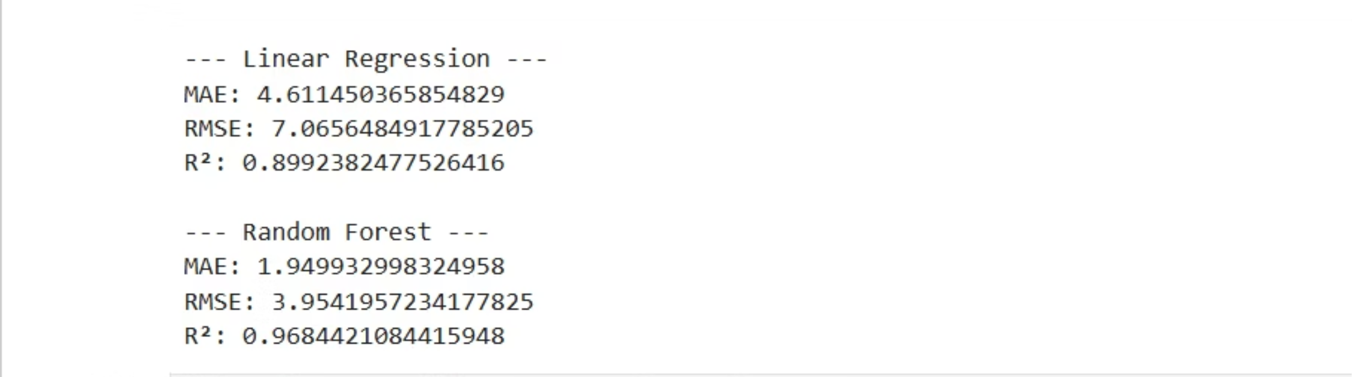
Python: Predictive Modeling
What was done
Generated:
Built a delivery time prediction model using:
Predicted delivery time
Distance
Prediction error
Preparation time
Absolute error
Courier experience
Delay risk category
Traffic & weather indicators
Focus
Business usefulness over pure accuracy
Highlighting high-risk and worst-case deliveries

Slide 5
Python: Key Insight
Model Performance Insight
56.26
56.16
Average Actual Delivery Time
Average Predicted Delivery Time
minutes
minutes
Insight
Model is well-calibrated on average
However, averages mask severe outliers
Operational issues, not prediction bias, drive SLA failures

Slide 6
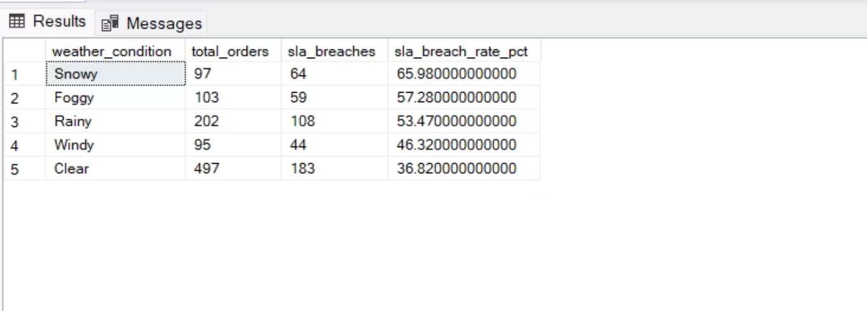
SQL: Business Analysis Layer
Why SQL was used
Convert model outputs into decision-ready metrics
Create a clean business view (vw_food_delivery_business)
Avoid misleading analysis from missing time fields
Key SQL Analyses
SLA breach by traffic, distance, weather
Courier experience vs SLA failure
Inefficient (slow + late) deliveries
Overall SLA compliance

Slide 7

SQL: Key Insights
Operational Findings
53.92%
SLA breaches increase with:
Long distances (10+ km)
Adverse weather (snow, fog)
Overall SLA Compliance
Traffic uncertainty
419 deliveries identified as inefficient (slow & late)
Insight
SLA failures are driven by execution and external conditions, not model inaccuracy.

Slide 8

Power BI Dashboard
Dashboard Purpose
Monitor delivery performance
Track SLA risk
Support operational decision-making
Dashboard Highlights
Actual vs Predicted validation
Distance & speed impact
Weather and traffic effects
Courier experience analysis
Traffic impact simulation (what-if analysis)

Slide 9
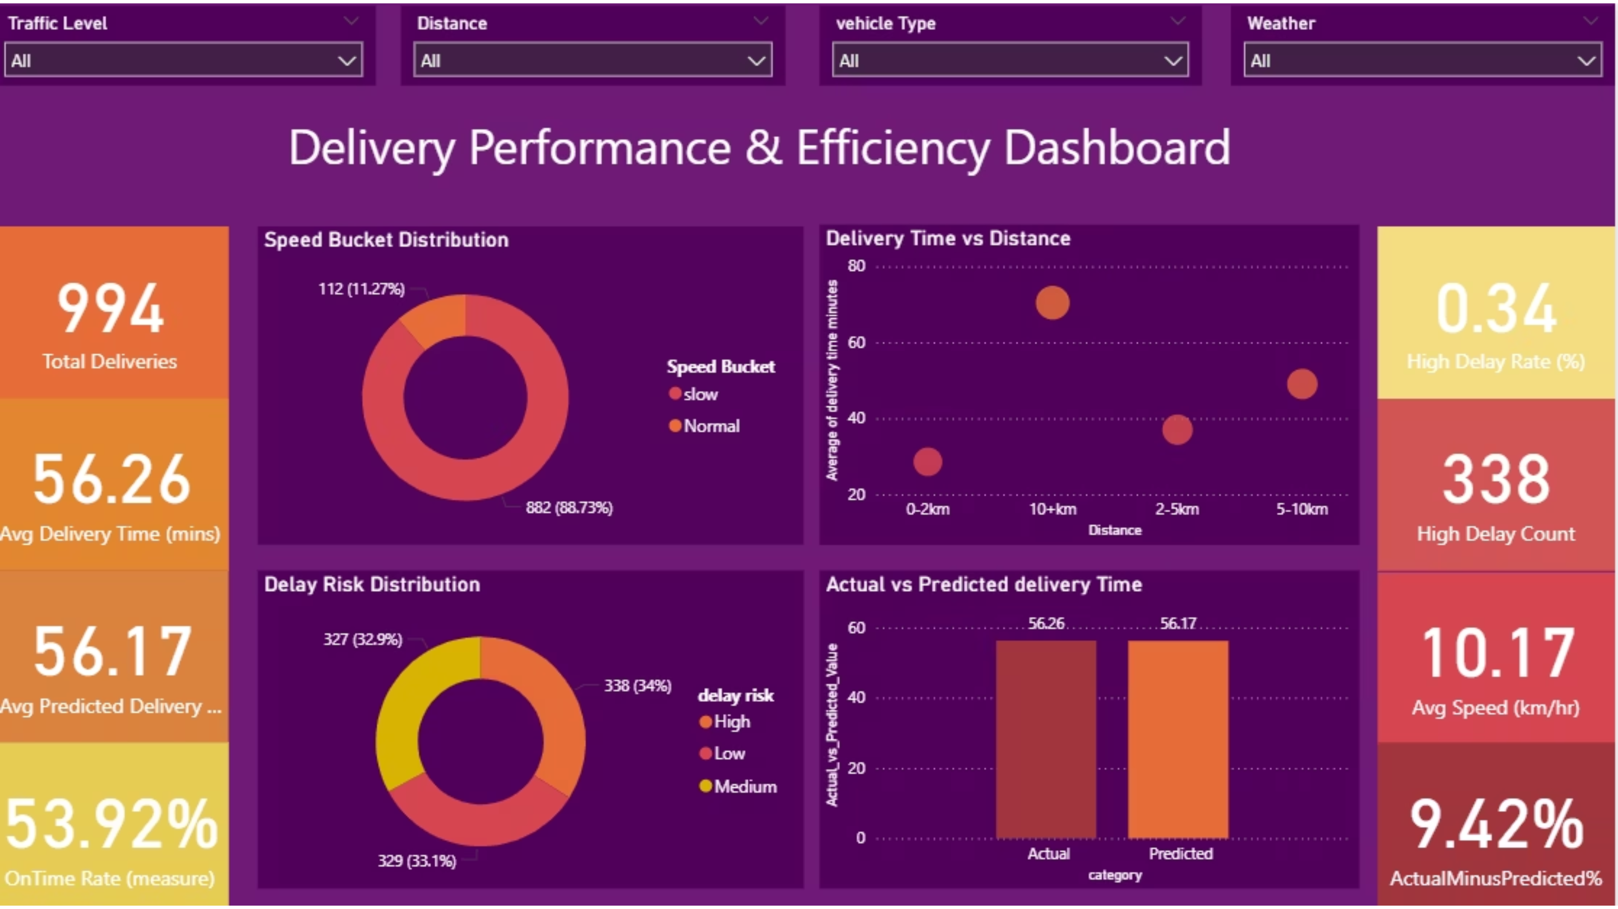

Slide 10
Business Impact & Recommendations
Key Takeaways
Prediction accuracy alone does not ensure SLA success
Distance, weather, and traffic are dominant risk drivers
Courier experience helps but does not eliminate delays
Recommendations
01
02
Introduce distance-based delivery controls
Add weather-aware ETA buffers
03
04
Focus on execution speed improvements
Proactively monitor high-risk deliveries

Slide 11

Conclusion
Conclusion
Built an end-to-end analytics solution combining:
Python
SQL
Power BI
(prediction)
(business logic)
(visual decision support)
Final Insight
Improving delivery reliability requires operational optimization, not just better prediction models.

